Slide 1
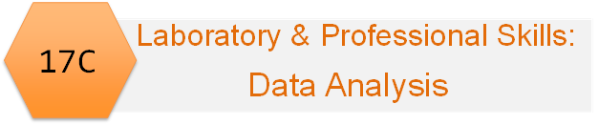
Laboratory & Professional skills for Bioscientists Term 2: Data Analysis in R
Week 5: Describing normal distributions and Confidence Intervals

Slide 2
Overview of topics
Week | Topic
3 | Introduction to module, statistics and RStudio including first figure, getting help in RStudio
4 | Hypothesis testing, variable types; functions (inbuilt ), different ways of getting data into RStudio
5 | Chi-squared tests
6 | The normal distribution, summary statistics and confidence intervals
7 | One- and two-sample t-tests and their non-parametric equivalents (2 lectures)
8 | One-way ANOVA and Kruskal-Wallis
9 | Two-way ANOVA incl understanding the interaction
10 | Correlation and regression

Slide 3
Summary of this week
The normal distribution, its properties and how to estimate population means from samples using confidence intervals.
In RStudio we will calculate summary statistics, probabilities, critical values (quantiles) and confidence intervals

Slide 4
Learning objectives for the week
By actively following the lecture and practical and carrying out the independent study the successful student will be able to:
Explain the properties of ‘normal distributions’ and their use in statistics (MLO 1 and 2)
Define, select and calculate with R probabilities, quantiles and confidence intervals (MLO 3 and 4)

Slide 5
To understand confidence intervals
We need to understand the standard error
To understand the standard error we need to understand the sample distribution of the mean
To understand the sampling distribution of the mean we need to understand a distribution

Slide 6
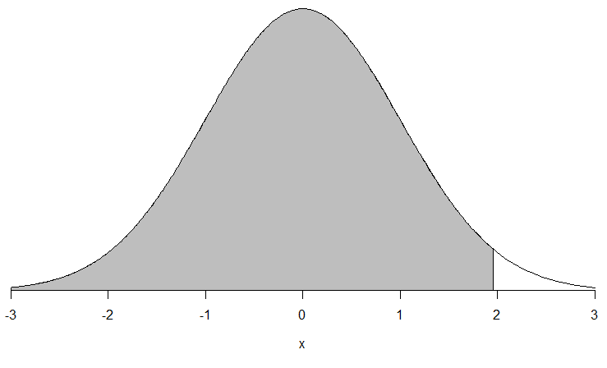
What is the normal distribution?
First: What do we mean by distribution?
Anything you might measure has a distribution
Distribution determines values a variable can take and the chance of them occurring
Distribution is a function (relationship)
Parameters tune the shape of the distribution
function
Probability: area
Value a variable can take

Slide 7
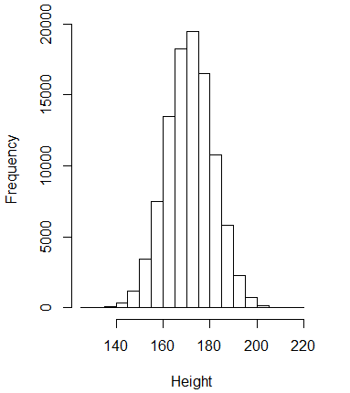
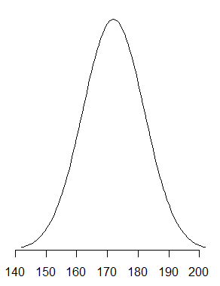
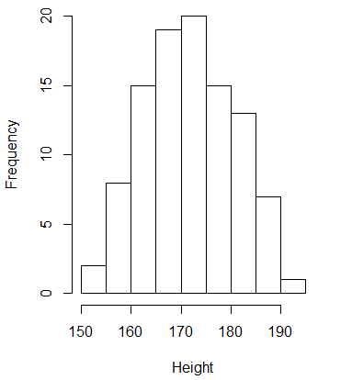
The normal distribution Many continuous variables are normally distributed
Noticed, not invented
E.g., height, length, concentration

Slide 8
The normal distribution Can vary in two ways – 2 parameters
Variance – how wide? Mean – where on the axis?

Slide 9
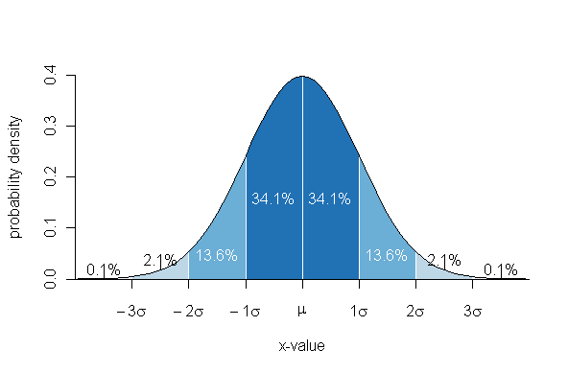
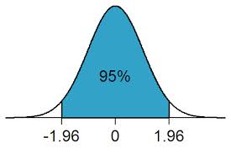
The normal distribution ….but with same properties
68% within 1 SD
of the mean
95% of observations are within 1.96 sd of the mean

Slide 10
The normal distribution Can vary in two ways – 2 parameters
Variance – how wide? Mean – where on the axis?

Slide 11
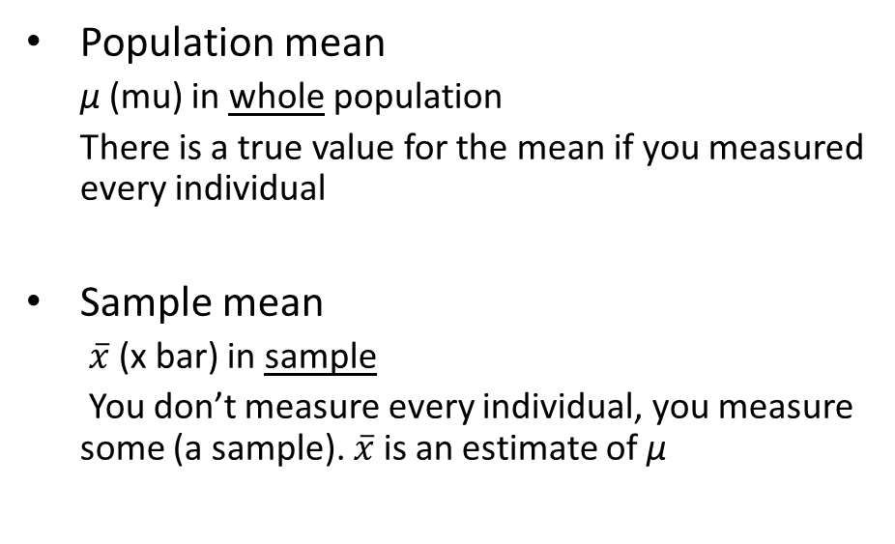
The normal distribution The mean
Population mean
μ (mu) in whole population
There is a true value for the mean if you measured every individual
Sample mean
$\overline{x}$ (x bar) in sample
You don’t measure every individual, you measure some (a sample). $\overline{x}$ is an estimate of μ

Slide 12
In a sample, each sample value differs from the mean. Each difference is called a deviation (or a residual) “average of the squared deviations from the mean”
The normal distribution The variance
Sample variance
s² (s-squared) in sample
You need to understand the concept rather than remember the formula

Slide 13
The normal distribution The standard deviation
“The average of the (absolute) deviations from the mean”
the square root of the variance
Sample standard deviation: s
Tells you how variable the values are
95% of observations are within 1.96 standard deviation of the mean
Notes:
Why we square.

Slide 14
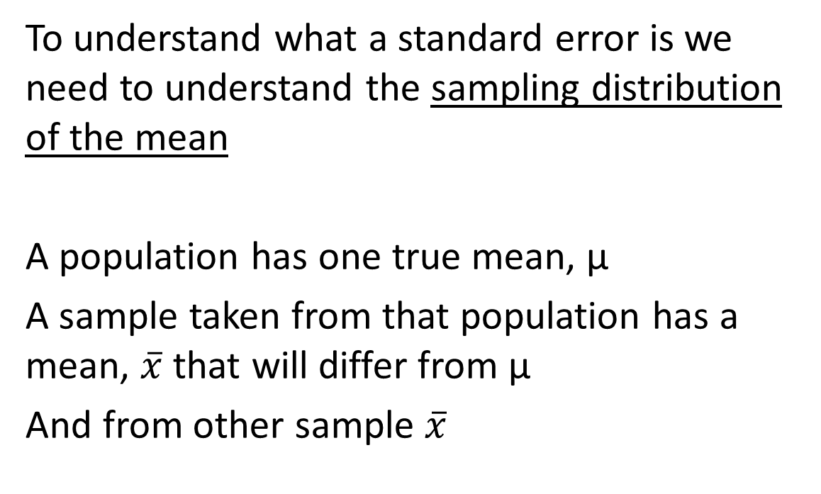
The normal distribution The standard error
To understand what a standard error is we need to understand the sampling distribution of the mean
A population has one true mean, μ
A sample taken from that population has a mean, $\overline{x}$ that will differ from μ
And from other sample $\overline{x}$
Notes:
Why we square.

Slide 15
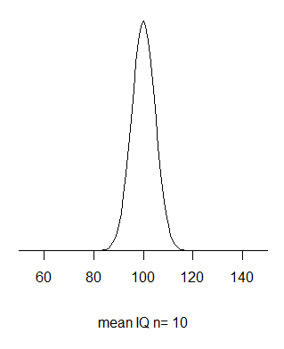
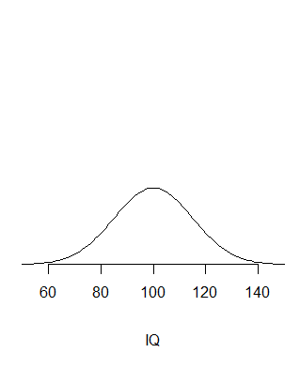
The normal distribution Sampling distribution of the mean
Many samples
All same size
e.g., n=10
Distribution – whole population
mean = 100
sd = 15
Each sample mean differs from 100 by chance
Distribution of the means

Slide 16
The normal distribution Sampling distribution of the mean
Has the same mean as the parent
But a different (lower) standard deviation
And we call it the ‘standard error’

Slide 17
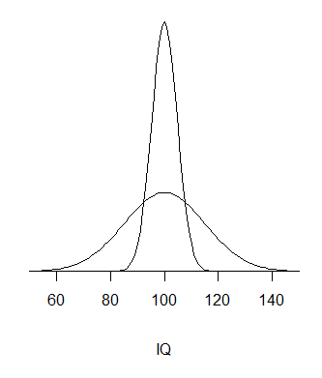
The normal distribution Sampling distribution of the mean
Whole population
mean = 100
sd = 15
Distribution of the means
mean = 100
se is related to sd in predictable way
se = sd/√n
Standard error: the standard deviation of the sample means.
Tells you how variable the sample means are

Slide 18
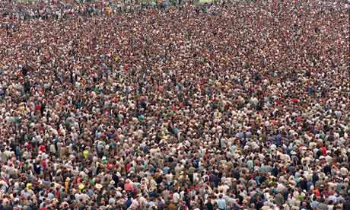


The normal distribution Sampling distribution of the mean
mean?
Why does it matter?
We usually only have samples!
We do not know population parameters
We use samples to estimate (inference)
Important - how likely is this sample
$$\overline{x}$$

Slide 19
The normal distribution Confidence intervals
How confident can we be that our sample mean is a good estimate of the true value?
Confidence intervals give the highest and lowest likely values
Likely means 95%, 99%, 99.9%

Slide 20
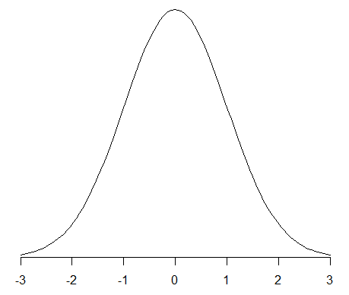
The normal distribution Confidence intervals: large samples
99%
95%
95% of sample means are within 1.96 s.e. of the population mean
99% of sample means are within 2.58 s.e. of the population mean
Notes:
Area under curve

Slide 21
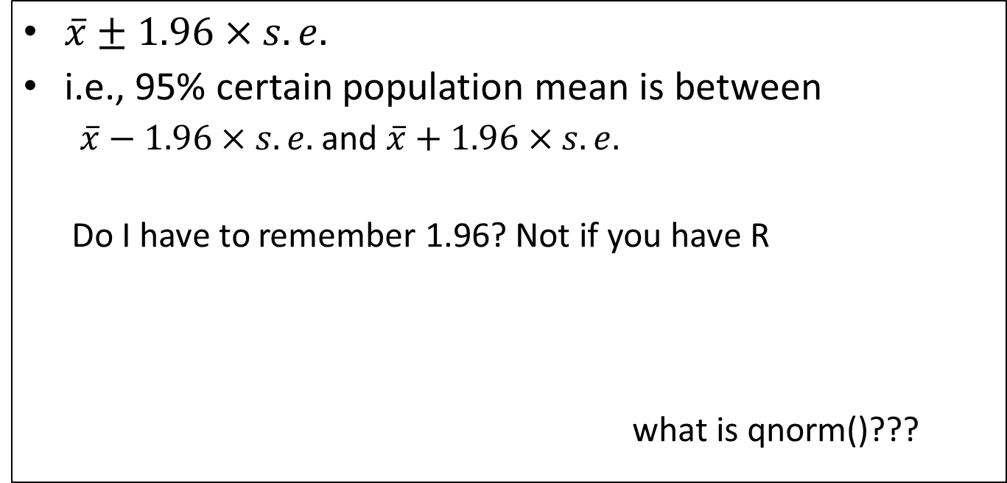
The normal distribution Confidence intervals: large samples
The mean plus or minus a bit
$\overline{x}±1.96×s.e.$
i.e., 95% certain population mean is between
$\overline{x}−1.96×s.e.$ and $\overline{x}+1.96×s.e.$
Do I have to remember 1.96? Not if you have R
what is qnorm()???
> qnorm(0.975)
[1] 1.959964

Slide 22
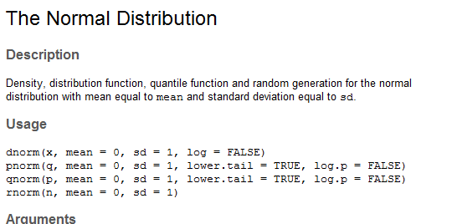
The normal distribution Confidence intervals: large samples
pnorm() and qnorm()
pnorm – maps value to probability
qnorm – maps probability to value
Much more practice in the practical!

Slide 23
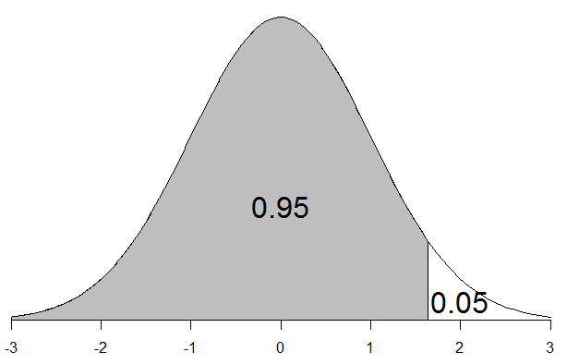
Why qnorm(0.975) and not qnorm(0.95)?
The normal distribution Confidence intervals: large samples
Because qnorm() gives ‘one-tailed’ probabilities
uses the lower tail = TRUE
(By default)

Slide 24
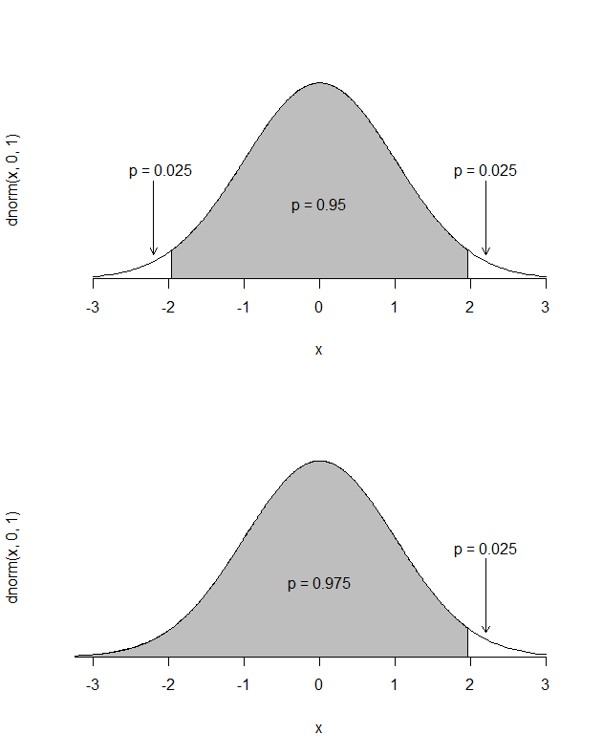
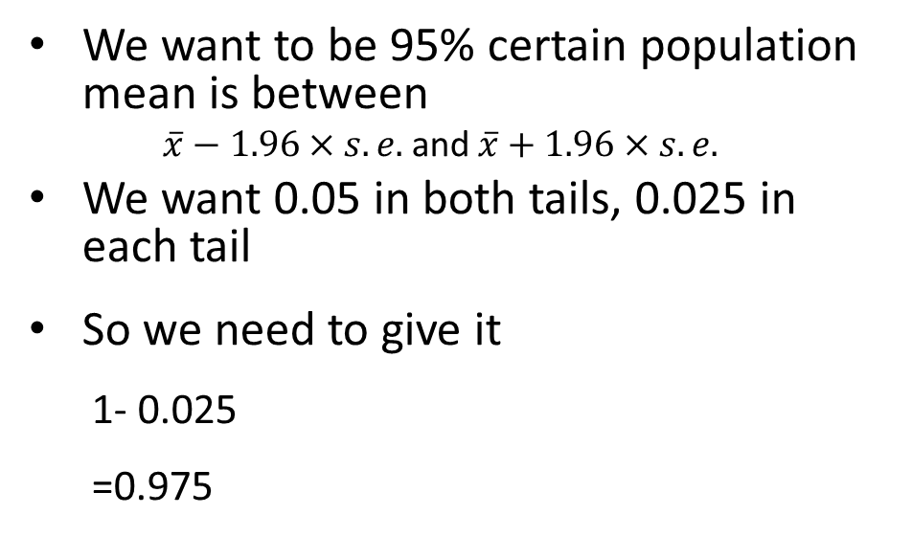
Why qnorm(0.975) and not qnorm(0.95)?
The normal distribution Confidence intervals: large samples
We want to be 95% certain population mean is between
$\overline{x}−1.96×s.e.$ and $\overline{x}+1.96×s.e.$
We want 0.05 in both tails, 0.025 in each tail
So we need to give it
1- 0.025
=0.975

Slide 25
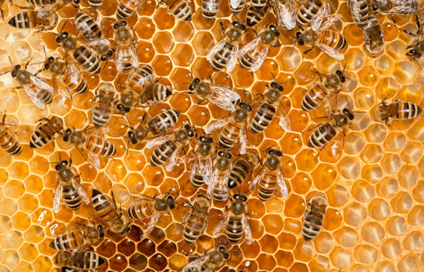
New population of honey bees – how big are their left wings?
The normal distribution Confidence intervals: large samples
Take a ‘representative’ sample

Slide 26
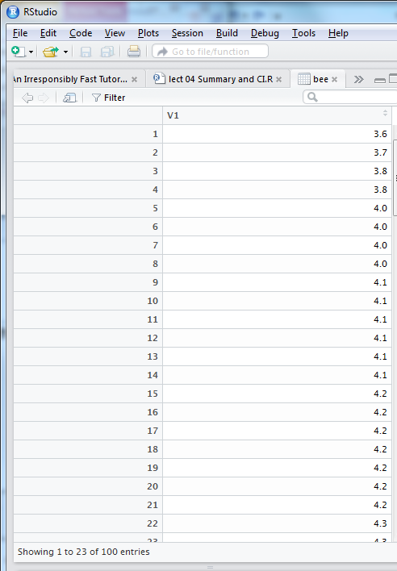
The normal distribution Confidence intervals: large samples
Left wing widths of 100 honey bees (mm)

Slide 27

The normal distribution Confidence intervals: large samples
Left wing widths of 100 honey bees (mm)
$$\overline{x}±1.96×s.e.$$
Mean
Standard error
quantile
amount to add/subtract
Upper confidence limit
Lower confidence limit
m <- mean(bee$V1)
[1] 4.55
se = sd/√n
se <- sd(bee$V1)/sqrt(length(bee$V1))
[1] 0.03919647
q <- qnorm(0.975)
[1] 1.959964
round(q * se, 2) # or q * se %>% round(2)
[1] 0.08
round(m + q * se, 2)
[1] 4.63
round(m – q * se, 2)
[1] 4.47

Slide 28
The normal distribution Confidence intervals: large samples
Left wing widths of 100 honey bees (mm)
Sample mean = 4.55 mm
95% certain population mean is between: 4.63 mm and 4.47 mm
We would normally summarise as:
The 95% confidence interval on the mean was 4.55 ± 0.08 mm.

Slide 29
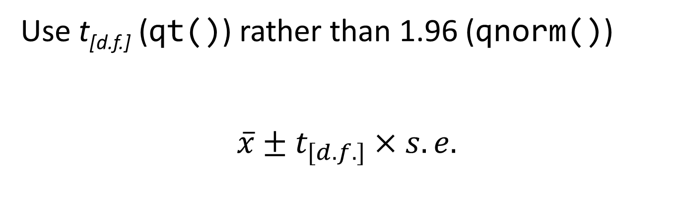
The normal distribution Confidence intervals: small samples
Use t_{[d.f.]} (qt()) rather than 1.96 (qnorm())
$$\overline{x}±t_{[d.f.]}×s.e.$$
(Sampling distribution of the mean for small samples is not quite normal but instead follows a t distribution)

Slide 30
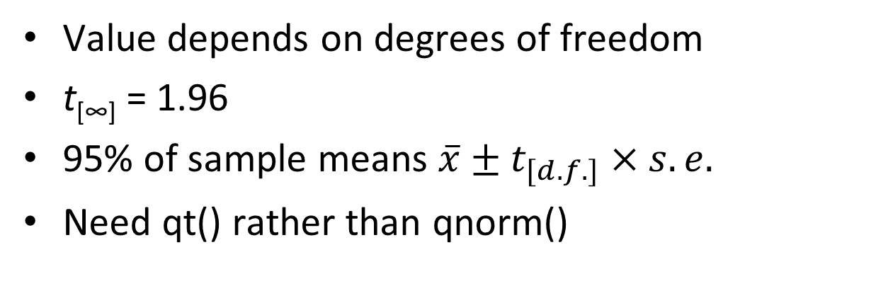
The normal distribution Confidence intervals: small samples
Value depends on degrees of freedom
t[∞] = 1.96
95% of sample means $\overline{x}±t_{[d.f.]}×s.e.$
Need qt() rather than qnorm()
> qt(0.975, df = 4)
[1] 2.776445
> qt(0.975, df = 9)
[1] 2.262157
> qt(0.975, df = 99)
[1] 1.984217
> qt(0.975, df = 999)
[1] 1.962341

Slide 31

The normal distribution Confidence intervals: small samples
19 lactate dehydrogenase solutions to a recipe that should yield a concentration of 1.5 μmols l⁻¹
How good is the recipe/ability to follow the recipe?

Slide 32
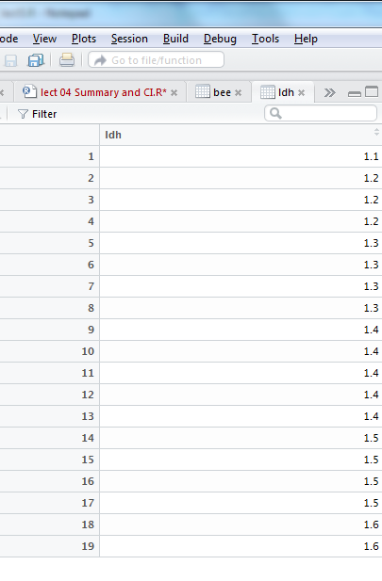
The normal distribution Confidence intervals: small samples
19 lactate dehydrogenase solutions to a recipe that should yield a concentration of 1.5 μmols l⁻¹
mean(ldh$ldh)
[1] 1.373684
Mean of sample is 1.37 μmols l⁻¹
What is an estimate the population mean?

Slide 33

The normal distribution Confidence intervals: small samples
$$\overline{x}±t_{[d.f.]}×s.e.$$
Mean
Standard error
qt – need df
Upper CL
Lower CL
m <- mean(ldh$ldh);m
1.373684
se <- sd(ldh$ldh)/sqrt(length(ldh$ldh)); se
[1] 0.03230167
df <- length(ldh$ldh) -1 ; df
[1] 18
t <- qt(0.975, df = df); t
[1] 2.100922
round(m + t * se, 2)
[1] 1.44
round(m - t * se, 2)
[1] 1.31

Slide 34
The normal distribution Confidence intervals: small samples
19 lactate dehydrogenase solutions to a recipe that should yield a concentration of 1.5 μmols l⁻¹
The 95% confidence interval on the mean was 1.37 ± 0.07 μmols l⁻¹.
95% certain population mean is between: 1.31 and 1.44 μmols l⁻¹
What does this tell us about the recipe/ability to follow recipe?

Slide 35
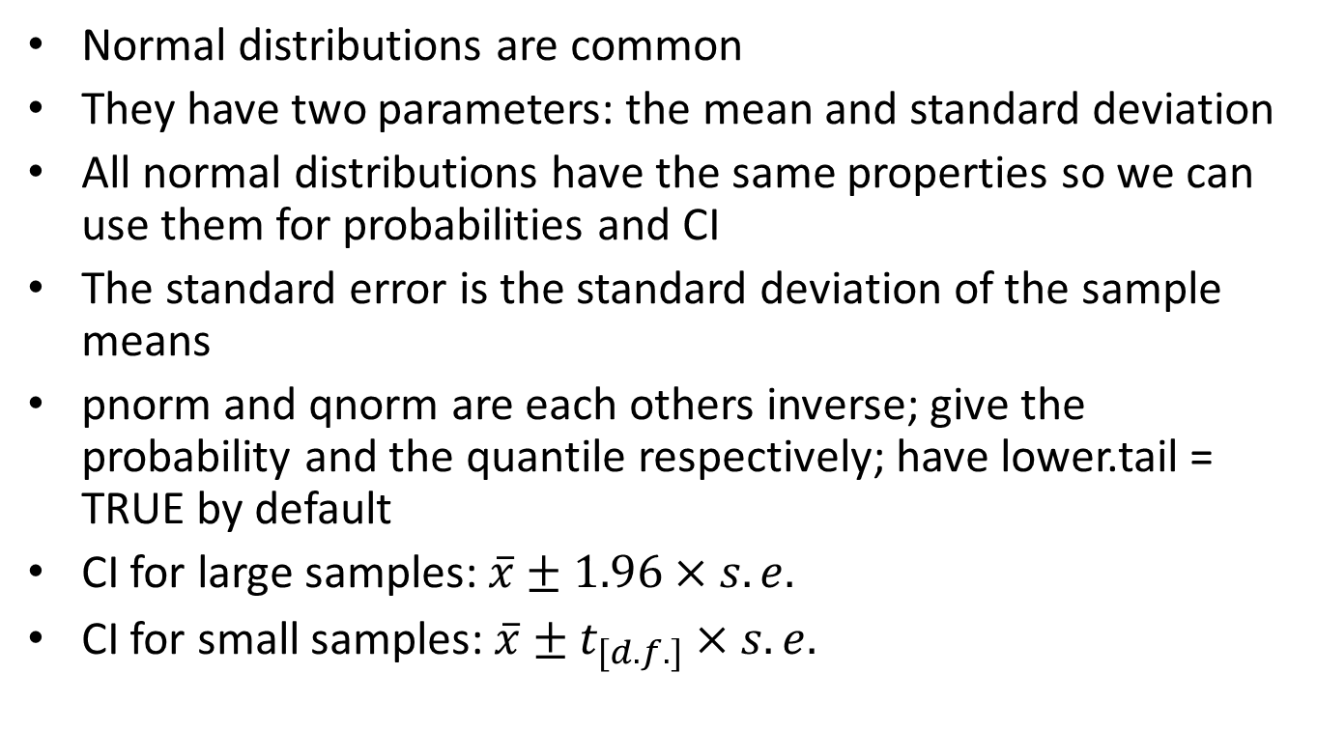
Summary
Normal distributions are common
They have two parameters: the mean and standard deviation
All normal distributions have the same properties so we can use them for probabilities and CI
The standard error is the standard deviation of the sample means
pnorm and qnorm are each others inverse; give the probability and the quantile respectively; have lower.tail = TRUE by default
CI for large samples: $\overline{x}±1.96×s.e.$
CI for small samples: $\overline{x}±t_{[d.f.]}×s.e.$

